Slide 1


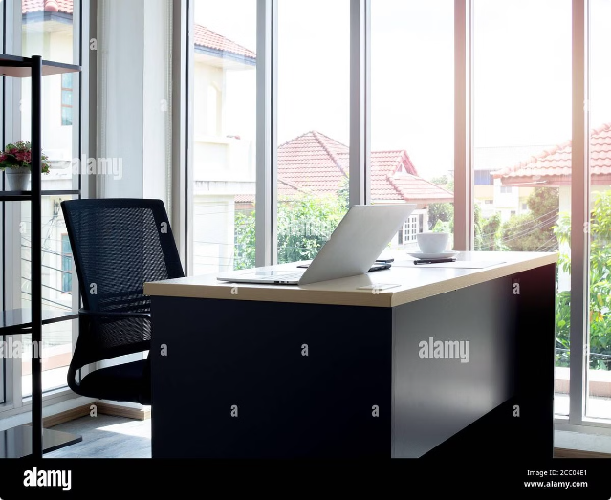

MY INTERNSHIP EXPERIENCE
WSA-MERN STACK
Presented By:
HIMANSHU MONDAL
himanshumondal03@gmail.com
by Himanshu Mondal
HM

Slide 2
Table of contents
1
Overview
2
Goals of Internship
Full-stack development is a rapidly growing field in technology, involving work on both the front-end and back-end of web applications. A full-stack developer needs a deep understanding of various technologies and programming languages, including HTML, CSS, JavaScript, React, Node.js, and MongoDB. In our internship, we utilized these technologies to build and manage complete web applications, gaining practical experience across the entire development process.
Gain foundational knowledge in HTML, CSS, and JavaScript to build and style web applications. Acquire a solid understanding of MongoD Express.js, React.js, and Node.js by working with these technologies in a real project. Develop practical skills in both front-end and back- end development by building and integrating features for the "Orderlt" food ordering system.
3
Full stack development
4
MERN STACK
Full-stack development is the process of designing, creating, and testing a complete web application. It involves working with a range of technologies and tools, including both front-end and back-end components. Full-stack developers are responsible for the entire development process, from initial design and coding to deployment and maintenance. They work with various technologies such as HTML, CSS, and JavaScript for the front- end, and server-side languages like Node.js, Python, or Ruby for the back-end. They also play a critical role in optimizing web applications for scalability and performance. They must have a deep understanding of how different components interact, ensuring that the front-end and back-end work seamlessly together. This often involves integrating APIs, managing version control systems like Git, and implementing responsive designs that work across various devices and screen sizes
Mongo Db is used to store and manage the application’s data. React.js is responsible for building the frontend user interface and handling user interactions. Express.js serves as the backend framework, handling HTTP requests, routing, and interaction with database. Node.js serves as the runtime environment for the server –side code, enabling communication between frontend and backend

Slide 3
Front-end development
HTML
CSS
JAVASCRIPT
HTML (HyperText Markup Language) is the standard language used to create and structure content on web pages. It defines the layout and elements like text, images, and links.
CSS (Cascading Style Sheets) is a language used to style and layout web pages. It controls the design, including colors, fonts, spacing, and positioning of elements, enhancing HTML content.
JavaScript is a programming language used to create interactive and dynamic content on web pages. It enables features like animations, form validations, and real-time updates, enhancing user experience.

Slide 4


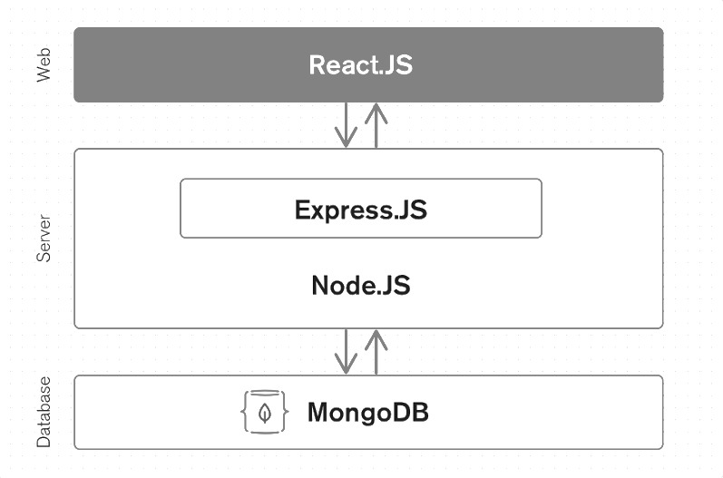


Architecture and design
Frontend
React.js
Backend
Node.js and Express.js
Database
MongoDB

Slide 5
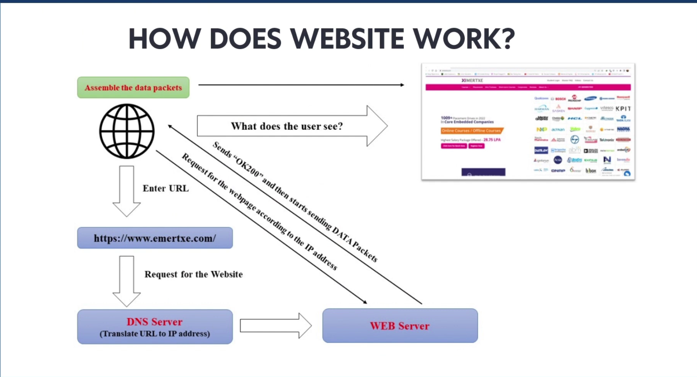

Slide 6

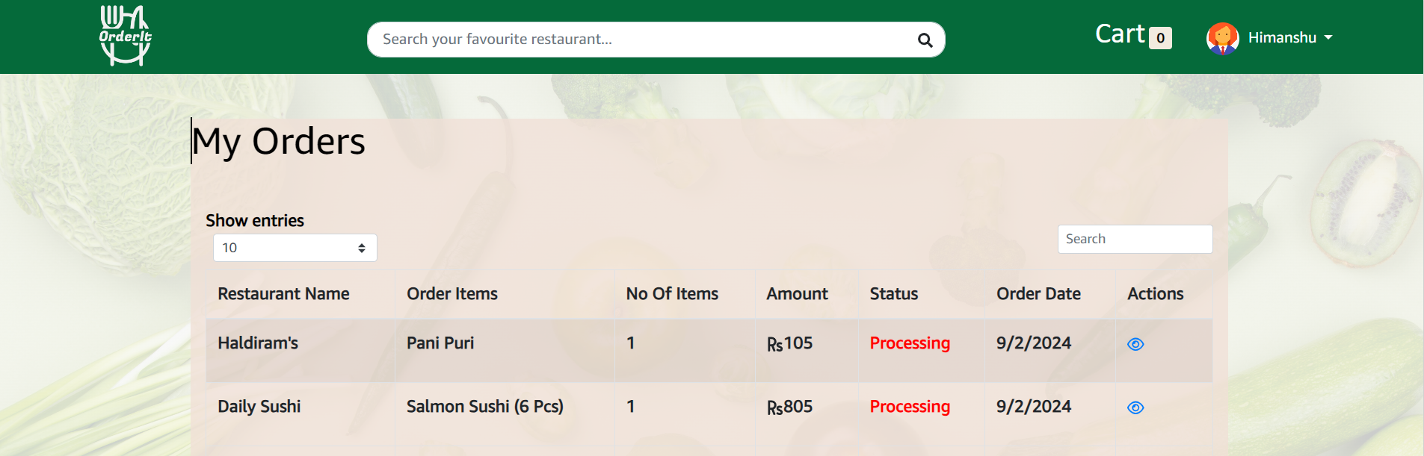
Project details
Food Delivery Application
This internship project presents a challenging and exciting opportunity to gain practical experience in Full stack development by creating a “Food Delivery Application” from scratch.
MERN stack
It is developed using the MERN stack i.e( MongoDB, Express.js, React.js, Node.js).
Technologies
Frontend- React.js Backend- Node.js and Express.js Database- MongoDB It also used Mailtrap and Stripe for mails and payments respectively.

Slide 7

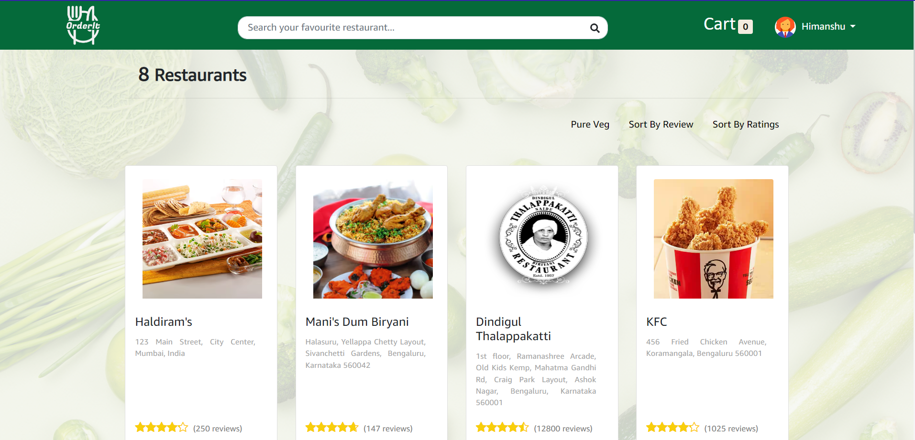
Functionalities
Display restaurants in home page
Search restaurant
Each restaurant has distinct menu
Can login and create account
Forgot password option is available
Has a cart which stores items we ordered
Can processed to payment
Can view orders
Can see profile and update it

Slide 8


Project live demo
The project is live.

Slide 9


Conclusion
My internship at Webstack Academy was a transformative experience that solidified my foundation in full-stack development, particularly with the MERN stack. By working on the "Orderlt" food ordering system, I not only honed my technical skills but also developed the confidence and competence needed to thrive in the tech industry. This internship has positioned me well for future opportunities in web development, and I'm eager to apply the knowledge and experience gained to real-world challenges

Slide 10
THANK YOU

